Slide 1
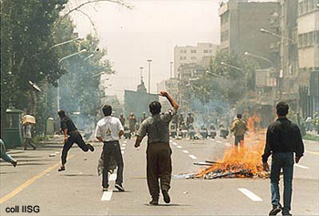

Freedom of Press

Slide 2
I. Federalizing effect of Amendment 14
II. Balancing Test once again applies
III. Controversial areas:
A. Right of access (Press has rights to information).
1. Generally granted to the press but not always.
2. “Sunshine Laws” require agencies to open their meetings to the public and press.
3. Freedom of Information Act (1966) Allows public access to government files.
4. Electronic Freedom of Information Act (1996) requires agencies to put files online. (Electronic reading rooms on agencies).

Slide 3
B. Executive Privilege
1. The right of presidents to withhold information from the courts.
2. U.S. v. Nixon, 1974
C. Gag orders may be issued by courts to ensure fair trials.
D. Shield Laws
1. Protect reporters from having to reveal their sources.
2. Press claims that without them, their sources would “dry up.”
3. Congress has not passed a shield law, but many states have.

Slide 4
E. Defamation
1. Distinction between libel and slander.
2. Neither is protected by Amendment 1.
3. To win a libel or slander case, one must generally prove that the allegations were false and that they damaged his/her reputation.
4. New York Times v. Sullivan (1968)

Slide 5
F. Obscenity
1. Not protected by Amendment 1.
2. Old standard for proving obscenity: Material must be utterly without redeeming value.
3. New standards set in Miller v. California (1973)
  Community standards must be violated.
  State obscenity laws must be violated.
  Material must lack serious literary/artistic/political value.

Slide 6
G. Regulation of Public Airwaves
1. Radio and television stations need a license from the FCC and must comply with FCC regulations.
2. Fairness Doctrine requires that stations allow a broad spectrum of viewpoints, but that was repealed by the FCC in 1987.
3. FCC restricts the use of obscene words and actions – fines have increased due to Janet Jackson’s 2004 “clothing malfunction” during the Super Bowl.
4. The Court struck down the Communications Decency Act in 1997, which had prohibited the circulation of indecent material on the internet to minors.

